Slide 1
Cyclistic Bicycle Sharing Company
A critical Analysis of The differences Between Casual Riders & Members
Analysis By
Joshua Cohen

Slide 2
Background
Cyclistic is a bicycle sharing company that operates in the Chicago market.
Currently, they have 5,824 geotracked bicycles and 692 stations to dock those bicycles in across the city.
Customers are subdivided into two categories
Casual Riders – users who opt to purchase either single-ride passes or full-day passes
Cyclistic members – users who purchase annual memberships

Slide 3
Shareholders
Executive Team – This team will consider the merits of the proposed marketing program.
Director of Marketing, Lilly Moreno – Lilly is tasked with creating Cyclistic’s marketing strategy.
Marketing Analytics team – This team will deliver actionable insights to Lilly to help her design the marketing strategy (I’m a junior Data Analyst on this team).

Slide 4
What Do We Want to know?
research conducted by our internal financial analysts show that members are more valuable financially than casual riders are. Based on this, Lilly Believes that focusing on increasing annual memberships might be the most lucrative long-term strategy for the company. Lilly has assigned the team several questions to answer relating to increasing annual membership. I have been assigned question number one.
1. How do annual members and casual riders use Cyclistic bikes differently?
2. Why would casual riders buy Cyclistic annual memberships?
3. How can Cyclistic use digital media to influence casual riders to become members?

Slide 5
Our Data Sources
The quarterly data used in this analysis comes from internal sources covering the time period Q2 2019 - Q1 2020.
This information is useful to us because it contains ridership data and a column which details the category of rider, which can be sorted and filtered to help us examine the differences between the 2 different categories of riders.

Slide 6
Preparing the data for Analysis
The csv data files used in our analysis were cleaned, combined, and analyzed using the programming language R in RStudio.
Cleaning Steps:
Prior to merging the files, it was apparent that some of the column names didn’t match, the rename() function was applied to 3 of the 4 data sheets to rectify the issue.
Equivalent columns in different DataFrames had differing data types. The mutate() and as.character() functions were used to homogenize these columns data types across DataFrames.
Certain columns that were irrelevant or had no equivalent were removed using select(-c(………)) command.
The member_casual column had four possible entries when there should have only been two. The mutate function, with a recode function nested within it, were used to change the two incorrect entries to correct entries.

Slide 7
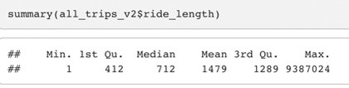
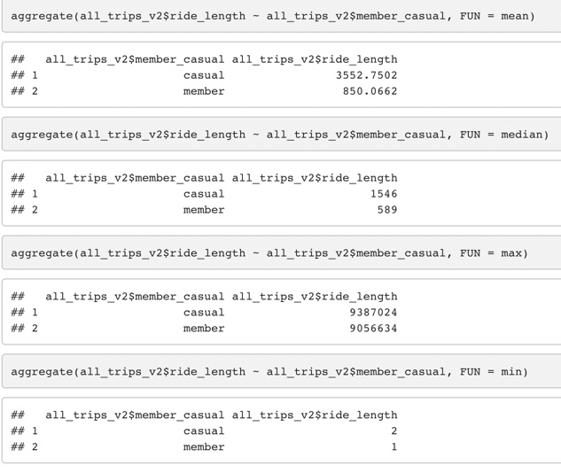
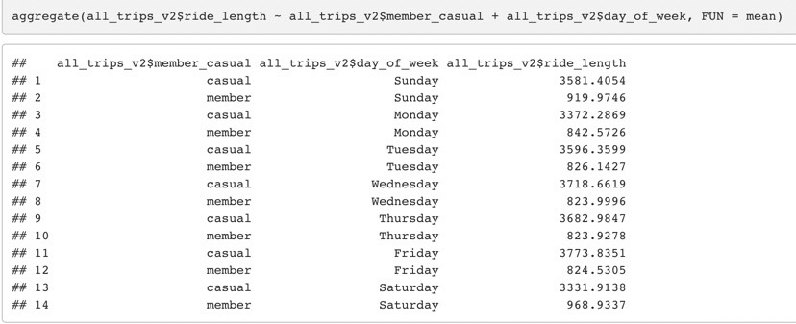
Analysis
How do annual members and casual riders use Cyclistic bikes differently?
THE DATA PROVIDES US WITH SEVERAL INSIGHTS:
The average ride length for casual riders is 4.18 times as long as it is for members (3553/850).
Current members use heavily on the weekends and less on the weekdays.
Alternatively, casual users skew heavily toward weekday use (Wednesday, Thursday, and Friday in particular).
Graphics on the next slide show that there are many more casual users than members.
The biggest rise in usage comes between March and August, it drops quickly from August until November, then falls slowly after that.

Slide 8
Analysis
Casual
Fewer current riders, longer average ride times, ride most frequently on weekdays
Member
More current riders, shorter average ride times, ride most frequently on the weekends
Conclusions
Since casual riders are using the bicycles heavily on the weekdays, that means that the majority of these riders are using the service during the work week. Conducting additional research to determine their exact purpose would be logical. Since the data provided for this case study is limited in scope, there are certain assumptions that we can make. Riders are probably either commuters, people who are using the bikes after work, or tourists who happen to be in town during weekdays. For a marketing campaign, we can focus on the first two groups, because focusing on tourists won’t be helpful since we cannot convert them to members.

Slide 9
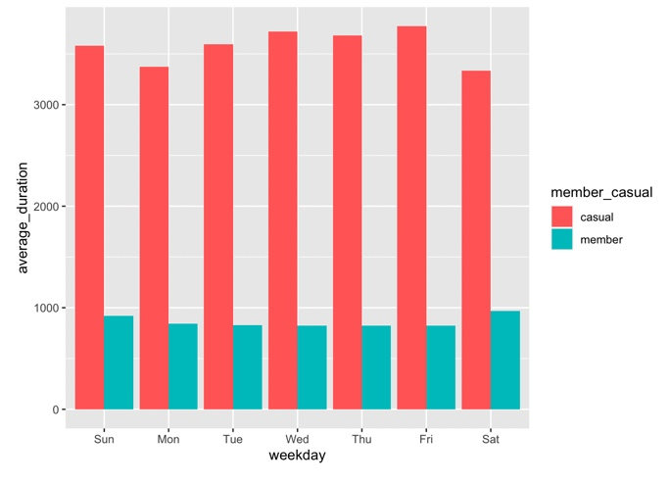
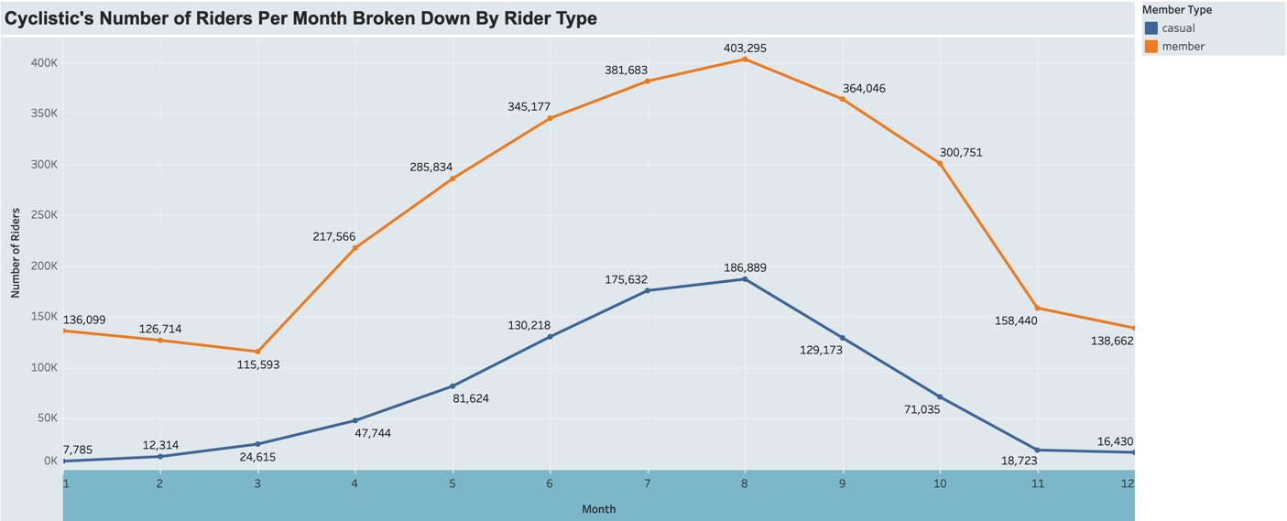
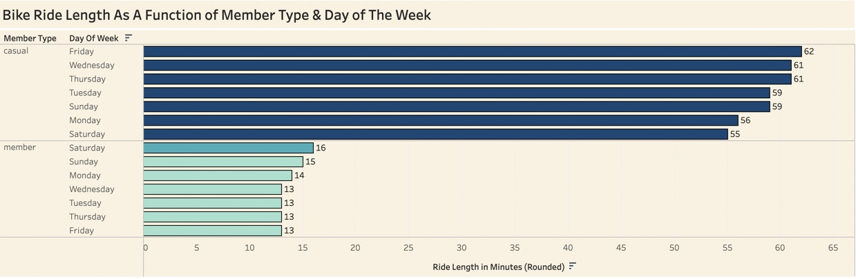
Visualizations For Shareholders
Top Left
Measures the average ride duration, in seconds, for casual users and members for every day of the week (created using the R programming language).
Top Right
Shows the number of riders per month broken down by the type of rider (created using Tableau).
Bottom
Details the length of the bike ride, in minutes, as a function of the member type and the day of the week (created using Tableau).

Slide 10
Acting On The Data
Individual Riders
To gain additional riders, we need to explain the financial benefits of having an annual membership Vs. using the bikes on an as needed basis. Aggressive pricing strategies to convert short-term users and running ads that focus on the financial benefits of switching user categories will be helpful. Primary or secondary research that focuses on the mediums used by the target market, their psychographics, and their demographics may further inform appropriate advertising strategy. Ads focusing on the benefits of commuting via bike compared to using car, bus, or train may help (with a focus on traffic and mechanical failures associated with other forms of transportation).
Going Corporate
If commuters are a major user category, targeting their place of employment or their healthcare insurance companies may be useful. Corporations are always trying to improve employee health, because it minimizes the number of sick days that workers need to utilize, during which time, they are out of the office and unproductive. Creating incentive programs to get employees that live within the city limits to use exercise bikes is a win for Cyclistic, employers within Chicago, and employees. Employees that commute using an annual membership program will save time at night to spend doing other things instead of having to go to a gym to work on their cardiovascular health.

Slide 11
Original Project Data Source
https://divvy-tripdata.s3.amazonaws.com/index.html

Slide 12
Thank You!
Thank you for taking the time to view my presentation!

